Slide 1
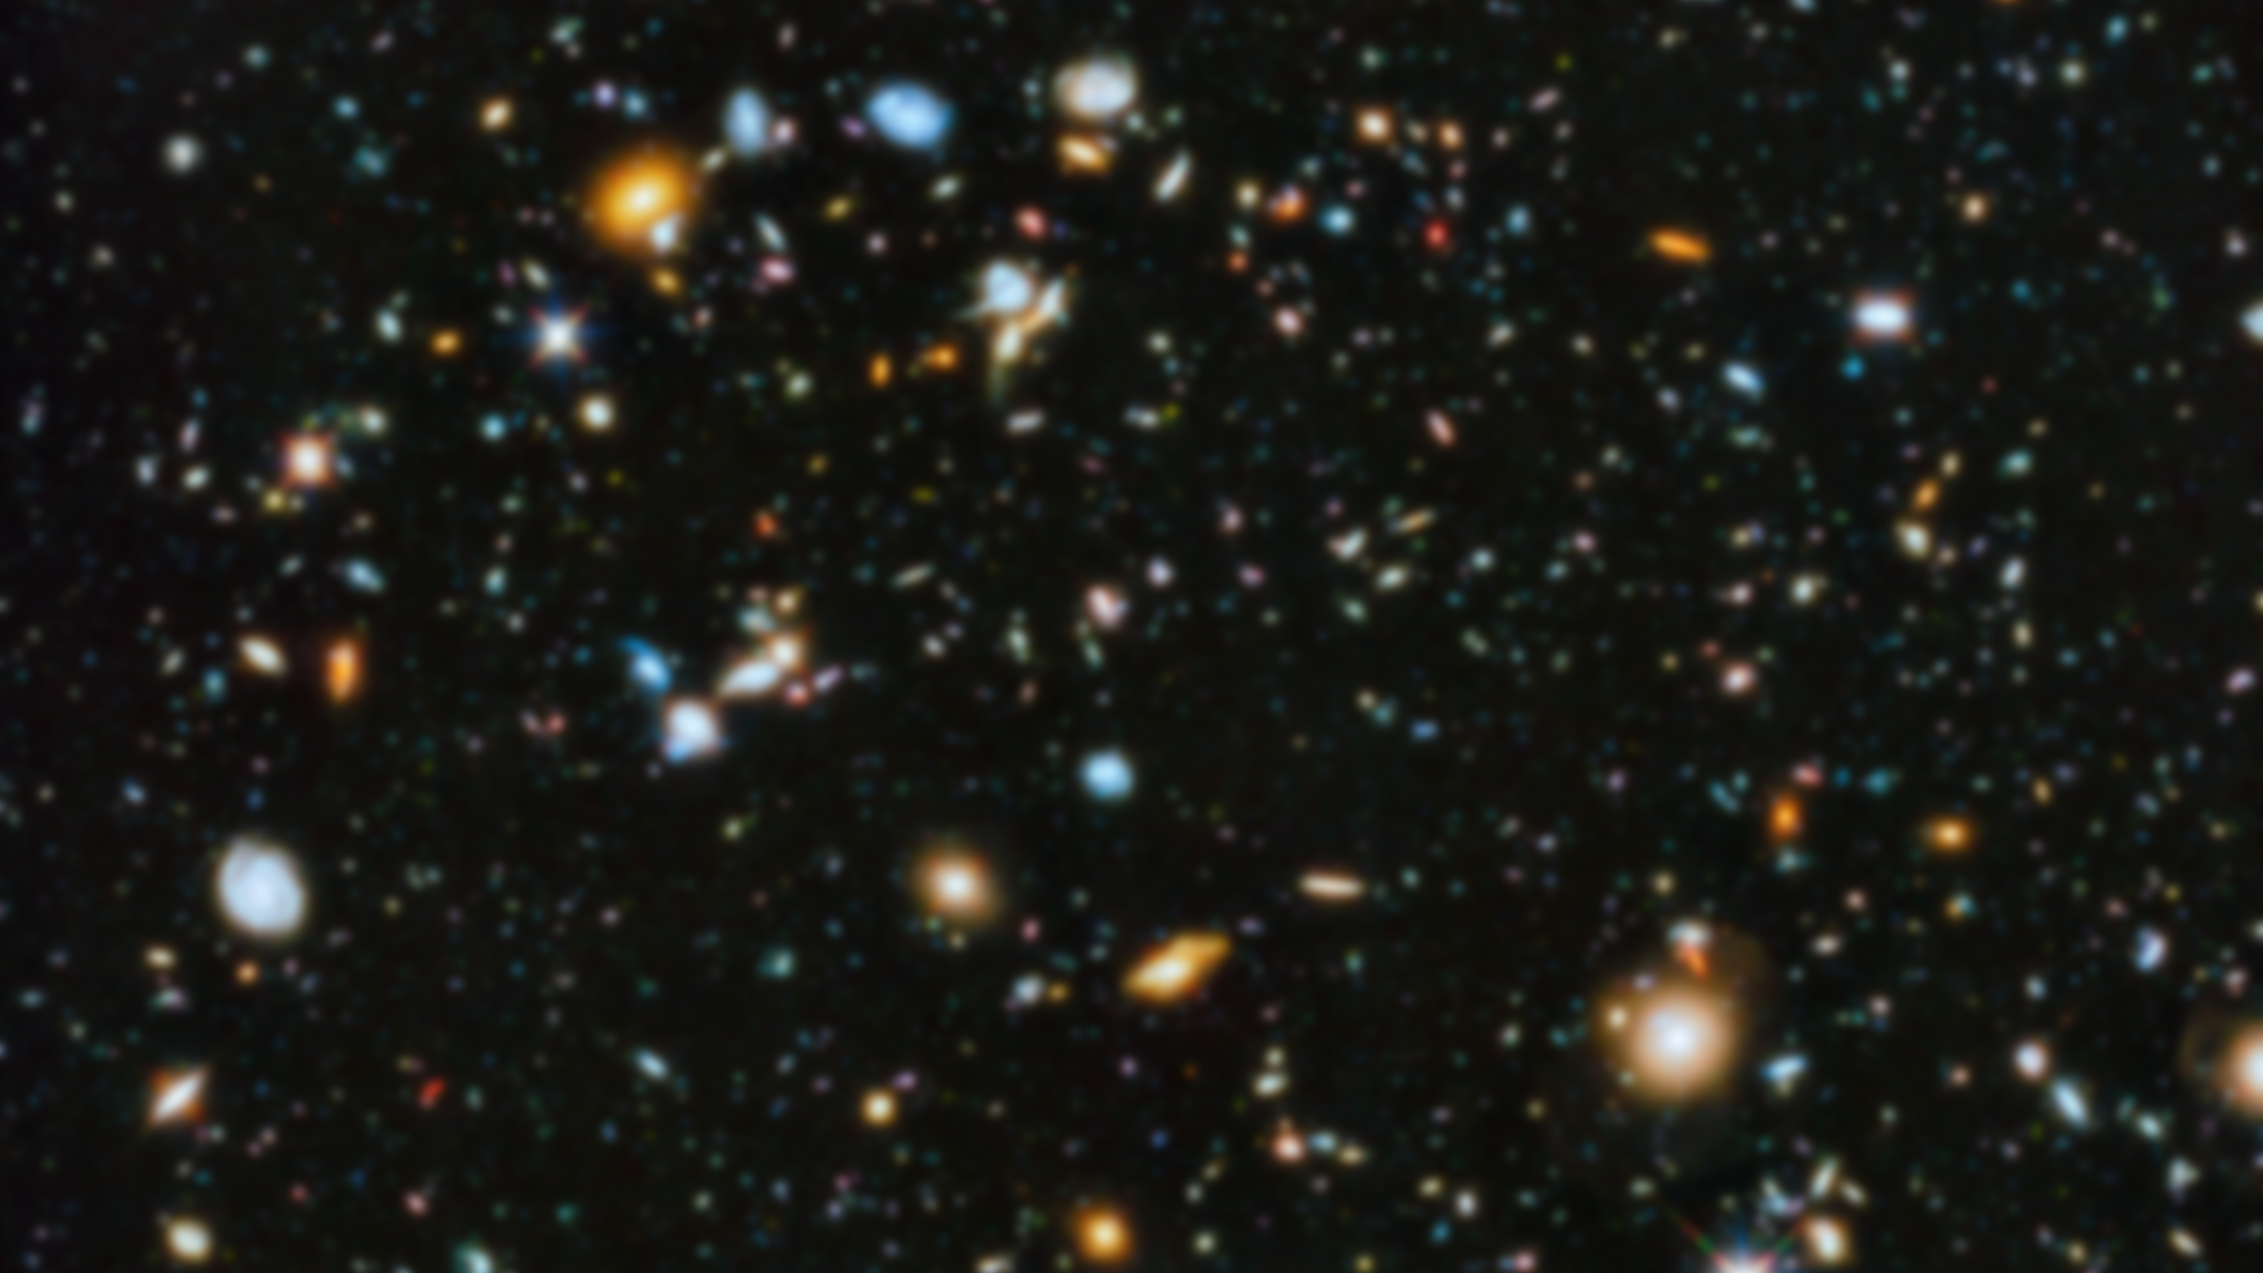
Conversion
From Base-r to Base-r’

Slide 2
(░)_{r} → (░)_{r’}

Slide 3
(░)_{r} → (░)₁₀
we already knew that: sum of the powers of r

Slide 4
Let (N)_{r} be a radix-r (base-r) number in a positional weighting number system, then
(N)_{r} = (d_{n-1} r^{n-1} + ... + d₀r⁰ . d₋₁ r⁻¹ + d₋₂ r⁻² + ... + d_{-m} r^{-m})₁₀
where:
r = radix (base)
d_{i} = digit at position i, 0 ≤ d_{i} ≤ r - 1
r^{i} = weight of position i
n = number of digits in integer part of N
m = number of digits in fraction part of N
Fraction Point

Slide 5
(░)_{r} ← (░)₁₀

Slide 6
(░)₁₀ ← (░)₁₀
To Come up with an Algorithm!

Slide 7
What is the digit in the position with significance of 10⁰?
( | 3 | 0 | 3 | 0 | 2 | 1 | 3 | 1 | )₁₀
Notes:
3×10^7+ 3×10^6+ 3×10^5+ 3×10^10+ 2×10^3+ 1×10^2+ 3×10^1+ 1×10^0 =

Slide 8
What is the digit in the position with significance of 10¹?
( | 3 | 0 | 3 | 0 | 2 | 1 | 3 | 1 | )₁₀
Notes:
3×10^7+ 3×10^6+ 3×10^5+ 3×10^10+ 2×10^3+ 1×10^2+ 3×10^1+ 1×10^0 =

Slide 9
What is the digit in the position with significance of 10²?
( | 3 | 0 | 3 | 0 | 2 | 1 | 3 | 1 | )₁₀
Notes:
3×10^7+ 3×10^6+ 3×10^5+ 3×10^10+ 2×10^3+ 1×10^2+ 3×10^1+ 1×10^0 =

Slide 10
What is the digit in the position with significance of 10^{i}?
(30302131)₁₀ → 10⁰ → 1
(30302131)₁₀ → 10¹ → 3
(30302131)₁₀ → 10² → 1
(30302131)₁₀ → 10³ → 2
(30302131)₁₀ → 10⁴ → 0
(30302131)₁₀ → 10⁵ → 3
(30302131)₁₀ → 10⁶ → 0
(30302131)₁₀ → 10⁷ → 3
Notes:
3×10^7+ 3×10^6+ 3×10^5+ 3×10^10+ 2×10^3+ 1×10^2+ 3×10^1+ 1×10^0 =

Slide 11
What is the digit in the position with significance of 10^{i}?
(30302131)₁₀ → 10⁰ → 1
(3030213)₁₀ → 10⁰ → 3
(303021)₁₀ → 10⁰ → 1
(30302)₁₀ → 10⁰ → 2
(3030)₁₀ → 10⁰ → 0
(303)₁₀ → 10⁰ → 3
(30)₁₀ → 10⁰ → 0
(3)₁₀ → 10⁰ → 3
Notes:
3×10^7+ 3×10^6+ 3×10^5+ 3×10^10+ 2×10^3+ 1×10^2+ 3×10^1+ 1×10^0 =

Slide 12
Divide by 10?
( | 3 | 0 | 3 | 0 | 2 | 1 | 3 | 1 | )₁₀
$$30,302,131 ÷ 10=3,030,213$$
$$30,302,131 \% 10=1$$
$$\frac{30,302,131}{10}=3,030,213 r 1$$
Notes:
3×10^7+ 3×10^6+ 3×10^5+ 3×10^10+ 2×10^3+ 1×10^2+ 3×10^1+ 1×10^0 =

Slide 13
Divide by 10?
( | 3 | 0 | 3 | 0 | 2 | 1 | 3 | 1 | )₁₀
$$3,030,213 ÷ 10=303,021$$
$$3,030,213 \% 10=3$$
$$\frac{3,030,213}{10}=303,021 r 3$$
Notes:
3×10^7+ 3×10^6+ 3×10^5+ 3×10^10+ 2×10^3+ 1×10^2+ 3×10^1+ 1×10^0 =

Slide 14
Divide by 10?
( | 3 | 0 | 3 | 0 | 2 | 1 | 3 | 1 | )₁₀
$$303,021 ÷ 10=30,302$$
$$303,021 \% 10=1$$
$$\frac{303,021}{10}=30,302 r 1$$
Notes:
3×10^7+ 3×10^6+ 3×10^5+ 3×10^10+ 2×10^3+ 1×10^2+ 3×10^1+ 1×10^0 =

Slide 15
What is the digit in the position with significance of 10⁰?
$$\frac{30,302,131}{10}=3,030,213 r 1$$
Remainder of the 0+1 division by 10!
Notes:
3×10^7+ 3×10^6+ 3×10^5+ 3×10^10+ 2×10^3+ 1×10^2+ 3×10^1+ 1×10^0 =

Slide 16
What is the digit in the position with significance of 10¹?
$$\frac{30,302,131}{10}=3,030,213 r 1$$
$$\frac{ }{10}=303,021 r 3$$
Remainder of the 1+1 division by 10!
Notes:
3×10^7+ 3×10^6+ 3×10^5+ 3×10^10+ 2×10^3+ 1×10^2+ 3×10^1+ 1×10^0 =

Slide 17
What is the digit in the position with significance of 10²?
$$\frac{30,302,131}{10}=3,030,213 r 1$$
$$\frac{ }{10}=303,021 r 3$$
$$\frac{ }{10}=30,302 r 1$$
Remainder of the 2+1 division by 10!
Notes:
3×10^7+ 3×10^6+ 3×10^5+ 3×10^10+ 2×10^3+ 1×10^2+ 3×10^1+ 1×10^0 =

Slide 18
What is the digit in the position with significance of 10³?
$$\frac{30,302,131}{10}=3,030,213 r 1$$
$$\frac{ }{10}=303,021 r 3$$
$$\frac{ }{10}=30,302 r 1$$
$$\frac{ }{10}=3,030 r 2$$
Remainder of the 3+1 division by 10!
Notes:
3×10^7+ 3×10^6+ 3×10^5+ 3×10^10+ 2×10^3+ 1×10^2+ 3×10^1+ 1×10^0 =

Slide 19
What is the digit in the position with significance of 10⁴?
$$\frac{30,302,131}{10}=3,030,213 r 1$$
$$\frac{ }{10}=303,021 r 3$$
$$\frac{ }{10}=30,302 r 1$$
$$\frac{ }{10}=3,030 r 2$$
$$\frac{ }{10}=303 r 0$$
Remainder of the 4+1 division by 10!
Notes:
3×10^7+ 3×10^6+ 3×10^5+ 3×10^10+ 2×10^3+ 1×10^2+ 3×10^1+ 1×10^0 =

Slide 20
What is the digit in the position with significance of 10⁵?
$$\frac{30,302,131}{10}=3,030,213 r 1$$
$$\frac{ }{10}=303,021 r 3$$
$$\frac{ }{10}=30,302 r 1$$
$$\frac{ }{10}=3,030 r 2$$
$$\frac{ }{10}=303 r 0$$
$$\frac{ }{10}=30 r 3$$
Remainder of the 5+1 division by 10!
Notes:
3×10^7+ 3×10^6+ 3×10^5+ 3×10^10+ 2×10^3+ 1×10^2+ 3×10^1+ 1×10^0 =

Slide 21
What is the digit in the position with significance of 10⁶?
$$\frac{30,302,131}{10}=3,030,213 r 1$$
$$\frac{ }{10}=303,021 r 3$$
$$\frac{ }{10}=30,302 r 1$$
$$\frac{ }{10}=3,030 r 2$$
$$\frac{ }{10}=303 r 0$$
$$\frac{ }{10}=30 r 3$$
$$\frac{ }{10}=3 r 0$$
Remainder of the 6+1 division by 10!
Notes:
3×10^7+ 3×10^6+ 3×10^5+ 3×10^10+ 2×10^3+ 1×10^2+ 3×10^1+ 1×10^0 =

Slide 22
What is the digit in the position with significance of 10⁷?
$$\frac{30,302,131}{10}=3,030,213 r 1$$
$$\frac{ }{10}=303,021 r 3$$
$$\frac{ }{10}=30,302 r 1$$
$$\frac{ }{10}=3,030 r 2$$
$$\frac{ }{10}=303 r 0$$
$$\frac{ }{10}=30 r 3$$
$$\frac{ }{10}=3 r 0$$
$$\frac{ }{10}=0 r 3$$
Remainder of the 7+1 division by 10!
Notes:
3×10^7+ 3×10^6+ 3×10^5+ 3×10^10+ 2×10^3+ 1×10^2+ 3×10^1+ 1×10^0 =

Slide 23
What is the digit in the position with significance of 10^{i}?
$$\frac{30,302,131}{10}=3,030,213 r 1$$
$$\frac{ }{10}=303,021 r 3$$
$$\frac{ }{10}=30,302 r 1$$
$$\frac{ }{10}=3,030 r 2$$
$$\frac{ }{10}=303 r 0$$
$$\frac{ }{10}=30 r 3$$
$$\frac{ }{10}=3 r 0$$
$$\frac{ }{10}=0 r 3$$
( | 3 | 0 | 3 | 0 | 2 | 1 | 3 | 1 | )₁₀
Notes:
3×10^7+ 3×10^6+ 3×10^5+ 3×10^10+ 2×10^3+ 1×10^2+ 3×10^1+ 1×10^0 =

Slide 24
(░)₁₆ ← (░)₁₀

Slide 25
What is the digit in the position with significance of 16⁰?
$$\frac{30,302,131}{16}=1,893,883 r 3$$
Remainder of the 0+1 division by 16!
Notes:
3×10^7+ 3×10^6+ 3×10^5+ 3×10^10+ 2×10^3+ 1×10^2+ 3×10^1+ 1×10^0 =

Slide 26
What is the digit in the position with significance of 16¹?
$$\frac{30,302,131}{16}=1,893,883 r 3$$
$$\frac{ }{16}=118,367 r 11$$
Remainder of the 1+1 division by 16!
Notes:
3×10^7+ 3×10^6+ 3×10^5+ 3×10^10+ 2×10^3+ 1×10^2+ 3×10^1+ 1×10^0 =

Slide 27
What is the digit in the position with significance of 16²?
$$\frac{30,302,131}{16}=1,893,883 r 3$$
$$\frac{ }{16}=118,367 r 11$$
$$\frac{ }{16}=7,397 r 15$$
Remainder of the 2+1 division by 16!
Notes:
3×10^7+ 3×10^6+ 3×10^5+ 3×10^10+ 2×10^3+ 1×10^2+ 3×10^1+ 1×10^0 =

Slide 28
What is the digit in the position with significance of 16³?
$$\frac{30,302,131}{16}=1,893,883 r 3$$
$$\frac{ }{16}=118,367 r 11$$
$$\frac{ }{16}=7,397 r 15$$
$$\frac{ }{16}=462 r 5$$
Remainder of the 3+1 division by 16!
Notes:
3×10^7+ 3×10^6+ 3×10^5+ 3×10^10+ 2×10^3+ 1×10^2+ 3×10^1+ 1×10^0 =

Slide 29
What is the digit in the position with significance of 16⁴?
$$\frac{30,302,131}{16}=1,893,883 r 3$$
$$\frac{ }{16}=118,367 r 11$$
$$\frac{ }{16}=7,397 r 15$$
$$\frac{ }{16}=462 r 5$$
$$\frac{ }{16}=28 r 14$$
Remainder of the 4+1 division by 16!
Notes:
3×10^7+ 3×10^6+ 3×10^5+ 3×10^10+ 2×10^3+ 1×10^2+ 3×10^1+ 1×10^0 =

Slide 30
What is the digit in the position with significance of 16⁵?
$$\frac{30,302,131}{16}=1,893,883 r 3$$
$$\frac{ }{16}=118,367 r 11$$
$$\frac{ }{16}=7,397 r 15$$
$$\frac{ }{16}=462 r 5$$
$$\frac{ }{16}=28 r 14$$
$$\frac{ }{16}=1 r 12$$
Remainder of the 5+1 division by 16!
Notes:
3×10^7+ 3×10^6+ 3×10^5+ 3×10^10+ 2×10^3+ 1×10^2+ 3×10^1+ 1×10^0 =

Slide 31
What is the digit in the position with significance of 16⁶?
$$\frac{30,302,131}{16}=1,893,883 r 3$$
$$\frac{ }{16}=118,367 r 11$$
$$\frac{ }{16}=7,397 r 15$$
$$\frac{ }{16}=462 r 5$$
$$\frac{ }{16}=28 r 14$$
$$\frac{ }{16}=1 r 12$$
$$\frac{ }{16}=0 r 1$$
Remainder of the 6+1 division by 16!
Notes:
3×10^7+ 3×10^6+ 3×10^5+ 3×10^10+ 2×10^3+ 1×10^2+ 3×10^1+ 1×10^0 =

Slide 32
What is the digit in the position with significance of 16⁶?
$$\frac{30,302,131}{16}=1,893,883 r 3$$
$$\frac{ }{16}=118,367 r 11$$
$$\frac{ }{16}=7,397 r 15$$
$$\frac{ }{16}=462 r 5$$
$$\frac{ }{16}=28 r 14$$
$$\frac{ }{16}=1 r 12$$
$$\frac{ }{16}=0 r 1$$
( | 1 | 12 | 14 | 5 | 15 | 11 | 3 | )₁₆
Notes:
3×10^7+ 3×10^6+ 3×10^5+ 3×10^10+ 2×10^3+ 1×10^2+ 3×10^1+ 1×10^0 =

Slide 33
What is the digit in the position with significance of 16⁶?
$$\frac{30,302,131}{16}=1,893,883 r 1$$
$$\frac{ }{16}=118,367 r 11$$
$$\frac{ }{16}=7,397 r 0$$
$$\frac{ }{16}=462 r 5$$
$$\frac{ }{16}=28 r 14$$
$$\frac{ }{16}=1 r 12$$
$$\frac{ }{16}=0 r 1$$
( | 1 | 12 | 14 | 5 | 15 | 11 | 3 | )₁₆
Notes:
1CE5FB3

Slide 34
1,2,3,4,5,6,7,8,9,A
1,2,3,4,5,6,7,8,9,B
1,2,3,4,5,6,7,8,9,C
1,2,3,4,5,6,7,8,9,D
1,2,3,4,5,6,7,8,9,E
1,2,3,4,5,6,7,8,9,F
= 9 + 1
= A + 1
= B + 1
= C + 1
= D + 1
= E + 1
= (10)₁₀
= (11)₁₀
= (12)₁₀
= (13)₁₀
= (14)₁₀
= (15)₁₀

Slide 35
What is the digit in the position with significance of 16⁶?
$$\frac{30,302,131}{16}=1,893,883 r 1$$
$$\frac{ }{16}=118,367 r 11$$
$$\frac{ }{16}=7,397 r 0$$
$$\frac{ }{16}=462 r 5$$
$$\frac{ }{16}=28 r 14$$
$$\frac{ }{16}=1 r 12$$
$$\frac{ }{16}=0 r 1$$
( | 1 | C | E | 5 | F | B | 3 | )₁₆
Notes:
1CE5FB3

Slide 36
(░)₈ ← (░)₁₀

Slide 37
What is the digit in the position with significance of 8^{i}?
Quotient | Remainder
30,302,131÷8 | 3
3787766÷8 | 6
473470÷8 | 6
59183÷8 | 7
7397÷8 | 5
924÷8 | 4
115÷8 | 3
14÷8 | 6
1÷8 | 1
0
(1CE5FB3)₁₆
(30,302,131)₁₀
(163457663)₈

Slide 38
(░)₄ ← (░)₁₀

Slide 39
What is the digit in the position with significance of 4^{i}?
Quotient | Remainder
30,302,131÷4 | 3
7575532÷4 | 0
1893883÷4 | 3
473470÷4 | 2
118367÷4 | 3
29591÷4 | 3
7397÷4 | 1
1849÷4 | 1
462÷4 | 2
115÷4 | 3
28÷4 | 0
7÷4 | 3
1÷4 | 1
0
(1CE5FB3)₁₆
(30,302,131)₁₀
(163457663)₈
(1303211332303)₄

Slide 40
(░)₂ ← (░)₁₀

Slide 41
What is the digit in the position with significance of 2^{i}?
Quotient | Remainder
30,302,131÷2 | 1
15151065÷2 | 1
7575532÷2 | 0
3787766÷2 | 0
1893883÷2 | 1
946941÷2 | 1
473470÷2 | 0
236735÷2 | 1
118367÷2 | 1
59183÷2 | 1
29591÷2 | 1
14795÷2 | 1
7397÷2 | 1
3698÷2 | 0
1849÷2 | 1
924÷2 | 0
462÷2 | 0
231÷2 | 1
115÷2 | 1
57÷2 | 1
28÷2 | 0
14÷2 | 0
7÷2 | 1
3÷2 | 1
1÷2 | 1
0
(1CE5FB3)₁₆
(30,302,131)₁₀
(163457663)₈
(1303211332303)₄
(1110011100101111110110011)₂

Slide 42
(░)_{r} ← (░)₁₀
1. Divide quotients by r
2. Keep the remainders as the digits in r
3. Put the remainders in reverse order
For r > 10, substitute the digits with valid digits, e.g., in Base-16: 15→F

Slide 43
(░)_{r} → (░)_{r’}
Any Base-r to Any Base-r’

Slide 44
(░)_{r} (░)_{r’}
→
→
(░)₁₀
Mediate through Base-10
Base-r → Base-10 → Base-r’

Slide 45
(1CE5FB3)₁₆→1×16⁶+C×16⁵+E×16⁴+5×16³+F×16²+B×16¹+3×16⁰
(1CE5FB3)₁₆→1×16⁶+12×16⁵+14×16⁴+5×16³+15×16²+11×16¹+3×16⁰
(1CE5FB3)₁₆→ (30,302,131)₁₀
(1CE5FB3)₁₆
Quotient | Remainder
30,302,131÷8 | 3
3787766÷8 | 6
473470÷8 | 6
59183÷8 | 7
7397÷8 | 5
924÷8 | 4
115÷8 | 3
14÷8 | 6
1÷8 | 1
0
→ (163457663)₈
Notes:
1CE5FB3

Slide 46
Fraction conversion

Slide 47
(0.░)₁₀ ← (0.░)₁₀
To Come up with an Algorithm!

Slide 48
What is the digit in the position with significance of 10^{-i}?
(0.26501)₁₀ → 10⁻¹ → 2
(0.26501)₁₀ → 10⁻² → 6
(0.26501)₁₀ → 10⁻³ → 5
(0.26501)₁₀ → 10⁻⁴ → 0
(0.26501)₁₀ → 10⁻⁵ → 1
Notes:
3×10^7+ 3×10^6+ 3×10^5+ 3×10^10+ 2×10^3+ 1×10^2+ 3×10^1+ 1×10^0 =

Slide 49
What is the digit in the position with significance of 10^{-i}?
(0.26501)₁₀ → 10⁻¹ → 2
(0.6501)₁₀ → 10⁻¹ → 6
(0.501)₁₀ → 10⁻¹ → 5
(0.01)₁₀ → 10⁻¹ → 0
(0.1)₁₀ → 10⁻¹ → 1
Notes:
3×10^7+ 3×10^6+ 3×10^5+ 3×10^10+ 2×10^3+ 1×10^2+ 3×10^1+ 1×10^0 =

Slide 50
Multiply by 10?
( | 0 | . | 2 | 6 | 5 | 0 | 1 | )₁₀
$$\text{0.26501} × 10=2.6501$$
Notes:
0.26501 * 10

Slide 51
Multiply by 10?
( | 0 | . | 2 | 6 | 5 | 0 | 1 | )₁₀
$$\text{0.6501} × 10=6.501$$
Notes:
0.26501 * 10

Slide 52
Fraction | Result | Integer Part
0.26501×10 | 2.6501 | 2
0.6501×10 | 6.501 | 6
0.501×10 | 5.01 | 5
0.01×10 | 0.1 | 0
0.1×10 | 1.0 | 1
0

Slide 53
(0.░)₁₆ ← (0.░)₁₀

Slide 54
Fraction | Result | Integer Part
0.26501×16 | 4.24016 | 4
0.24016×16 | 3.84256 | 3
0.84256×16 | 13.48096 | 13 = D
0.48096×16 | 7.69536 | 7
0.69536×16 | 11.12576 | 11 = B
0.12576×16 | 2.01216 | 2
0.01216×16 | 0.19456 | 0
0.194560006×16 | 3.11296 | 3
0.1129601×16 | 1.807362 | 1
0.807361603×16 | 12.91779 | 12 = C
0.917785645×16 | 14.68457 | 14 = E
0.684570313×16 | 10.95313 | 10 = A
0.953125×16 | 15.25 | 15 = F
0.25×16 | 4 | 4
0 | 0 | 0
(0.26501)₁₀ → (0.43D7B2031CEAF40)₁₆
Notes:
43 13 7 11 2031 12 14 10 15 40

Slide 55
(0.░)₈ ← (0.░)₁₀
(0.░)₄ ← (0.░)₁₀
(0.░)₂ ← (0.░)₁₀
_{Microsoft excel sheet}

Slide 56
(░.░)_{r} (░.░)_{r’}
→
→
(░.░)₁₀
Integer Part independent of Fraction Part!

Slide 57
(░ .)_{r} (░ .)_{r’}
→
→
(░ .)₁₀
Integer Part

Slide 58
(. ░)_{r} (. ░)_{r’}
→
→
(. ░)₁₀
Fraction Part

Slide 59
(30,302,131. 26501)₁₀ | (163457663.20753….)₈
Quotient | Remainder
30,302,131÷8 | 3
3787766÷8 | 6
473470÷8 | 6
59183÷8 | 7
7397÷8 | 5
924÷8 | 4
115÷8 | 3
14÷8 | 6
1÷8 | 1
0
Fraction | Result | Integer Part
0.26501×8 | 2.12008 | 2
0.12008×8 | 0.96064 | 0
0.96064×8 | 7.68512 | 7
0.68512×8 | 5.48096 | 5
0.48096×8 | 3.84768 | 3
0.84768×8 | 6.78144 | 6
0.78144×8 | 6.25152 | 6
0.25152×8 | 2.01216 | 2
0.01216×8 | 0.09728 | 0
… | … | …

Slide 60
Base-2 → Base-[2², 2³, 2⁴, 2^{n}]
_{Lecture assignment}

Slide 61
Base-2 ← Base-[2², 2³, 2⁴, 2^{n}]
_{Lecture assignment}

Slide 62
https://planetcalc.com/862/

Slide 63
arithmetic

Slide 64
addition

Slide 65
+ Base-16 |  | 2 | A | . | E | 5 | 4
 | 4 | B | F | . | 2 | B
 |  |  |  | .

Slide 66
padding
+ Base-16 | 0 | 2 | A | . | E | 5 | 4
 | 4 | B | F | . | 2 | B | 0
 |  |  |  | .

Slide 67
+ Base-16 | 0 | 2 | A | . | E | 5 | 4
 | 4 | B | F | . | 2 | B | 0
 |  |  |  | . |  |  | 4

Slide 68
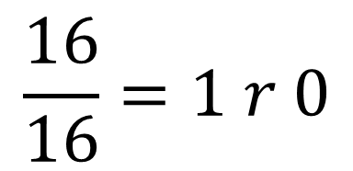
+ Base-16 | 0 | 2 | A | . | E | 5 | 4
 | 4 | B | F | . | 2 | B=11 | 0
 |  |  |  | . |  | 16 | 4
$$\frac{16}{16}=1 r 0$$

Slide 69
 |  |  |  |  | 1
+ Base-16 | 0 | 2 | A | . | E | 5 | 4
 | 4 | B | F | . | 2 | B | 0
 |  |  |  | . |  | 0 | 4
$$\frac{16}{16}=1 r 0$$

Slide 70
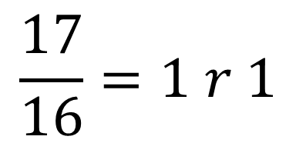
 |  |  |  |  | 1
+ Base-16 | 0 | 2 | A | . | E=14 | 5 | 4
 | 4 | B | F | . | 2 | B | 0
 |  |  |  | . | 17 | 0 | 4
$$\frac{17}{16}=1 r 1$$

Slide 71
 |  |  | 1 |  | 1
+ Base-16 | 0 | 2 | A | . | E | 5 | 4
 | 4 | B | F | . | 2 | B | 0
 |  |  |  | . | 1 | 0 | 4
$$\frac{17}{16}=1 r 1$$

Slide 72
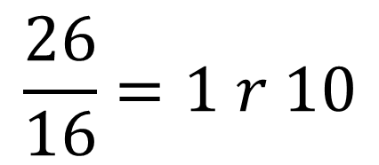
 |  |  | 1 |  | 1
+ Base-16 | 0 | 2 | A=10 | . | E | 5 | 4
 | 4 | B | F=15 | . | 2 | B | 0
 |  |  | 26 | . | 1 | 0 | 4
$$\frac{26}{16}=1 r 10$$

Slide 73
 |  | 1 | 1 |  | 1
+ Base-16 | 0 | 2 | A | . | E | 5 | 4
 | 4 | B | F | . | 2 | B | 0
 |  |  | 10 | . | 1 | 0 | 4
$$\frac{26}{16}=1 r 10$$

Slide 74
 |  | 1 | 1 |  | 1
+ Base-16 | 0 | 2 | A | . | E | 5 | 4
 | 4 | B | F | . | 2 | B | 0
 |  |  | A | . | 1 | 0 | 4

Slide 75
 |  | 1 | 1 |  | 1
+ Base-16 | 0 | 2 | A | . | E | 5 | 4
 | 4 | B=11 | F | . | 2 | B | 0
 |  | 14 | A | . | 1 | 0 | 4

Slide 76
 |  | 1 | 1 |  | 1
+ Base-16 | 0 | 2 | A | . | E | 5 | 4
 | 4 | B | F | . | 2 | B | 0
 |  | E | A | . | 1 | 0 | 4

Slide 77
 |  | 1 | 1 |  | 1
+ Base-16 | 0 | 2 | A | . | E | 5 | 4
 | 4 | B | F | . | 2 | B | 0
 | 4 | E | A | . | 1 | 0 | 4

Slide 78
multiply

Slide 79
subtraction

Slide 80
subtraction
Example I

Slide 81
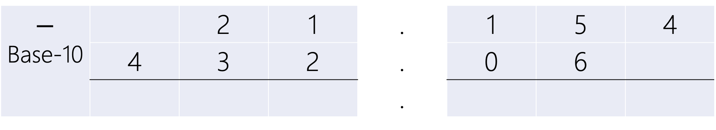
$$−$$ Base-10 |  | 2 | 1 | . | 1 | 5 | 4
 | 4 | 3 | 2 | . | 0 | 6
 |  |  |  | .

Slide 82
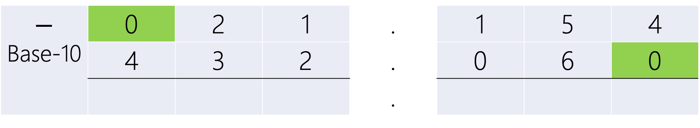
padding
$$−$$ Base-10 | 0 | 2 | 1 | . | 1 | 5 | 4
 | 4 | 3 | 2 | . | 0 | 6 | 0
 |  |  |  | .

Slide 83
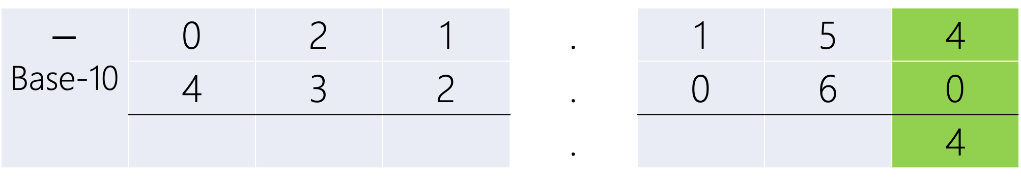
$$−$$ Base-10 | 0 | 2 | 1 | . | 1 | 5 | 4
 | 4 | 3 | 2 | . | 0 | 6 | 0
 |  |  |  | . |  |  | 4

Slide 84
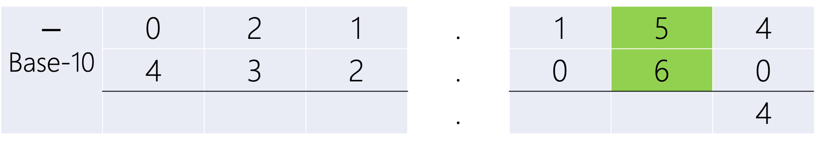
$$−$$ Base-10 | 0 | 2 | 1 | . | 1 | 5 | 4
 | 4 | 3 | 2 | . | 0 | 6 | 0
 |  |  |  | . |  |  | 4

Slide 85
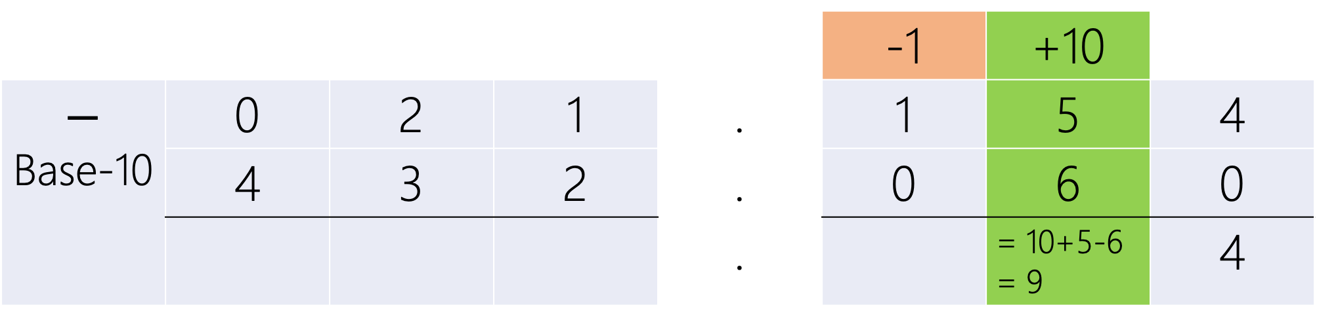
Borrow
 |  |  |  |  | -1 | +10
$$−$$ Base-10 | 0 | 2 | 1 | . | 1 | 5 | 4
 | 4 | 3 | 2 | . | 0 | 6 | 0
 |  |  |  | . |  | = 10+5-6 = 9 | 4

Slide 86
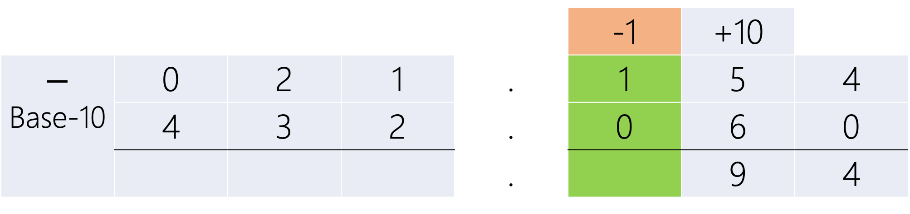
 |  |  |  |  | -1 | +10
$$−$$ Base-10 | 0 | 2 | 1 | . | 1 | 5 | 4
 | 4 | 3 | 2 | . | 0 | 6 | 0
 |  |  |  | . |  | 9 | 4

Slide 87

 |  |  |  |  | -1 | +10
$$−$$ Base-10 | 0 | 2 | 1 | . | 1 | 5 | 4
 | 4 | 3 | 2 | . | 0 | 6 | 0
 |  |  |  | . | 0 | 9 | 4

Slide 88
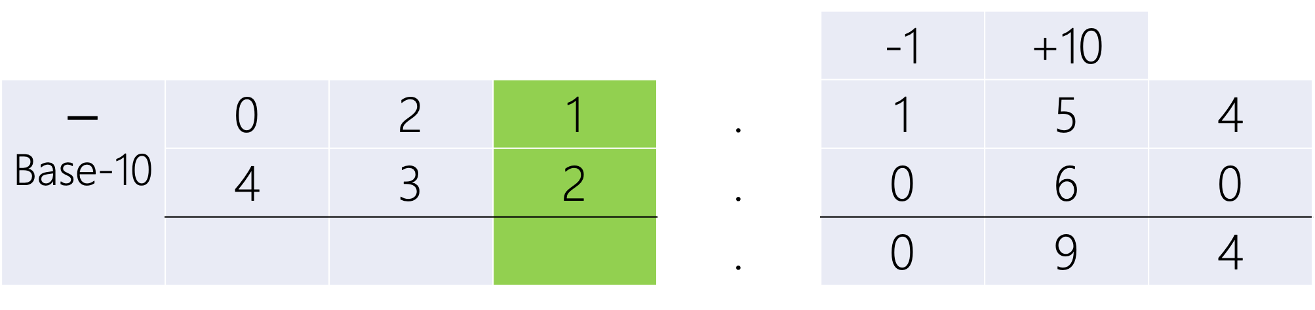
 |  |  |  |  | -1 | +10
$$−$$ Base-10 | 0 | 2 | 1 | . | 1 | 5 | 4
 | 4 | 3 | 2 | . | 0 | 6 | 0
 |  |  |  | . | 0 | 9 | 4

Slide 89
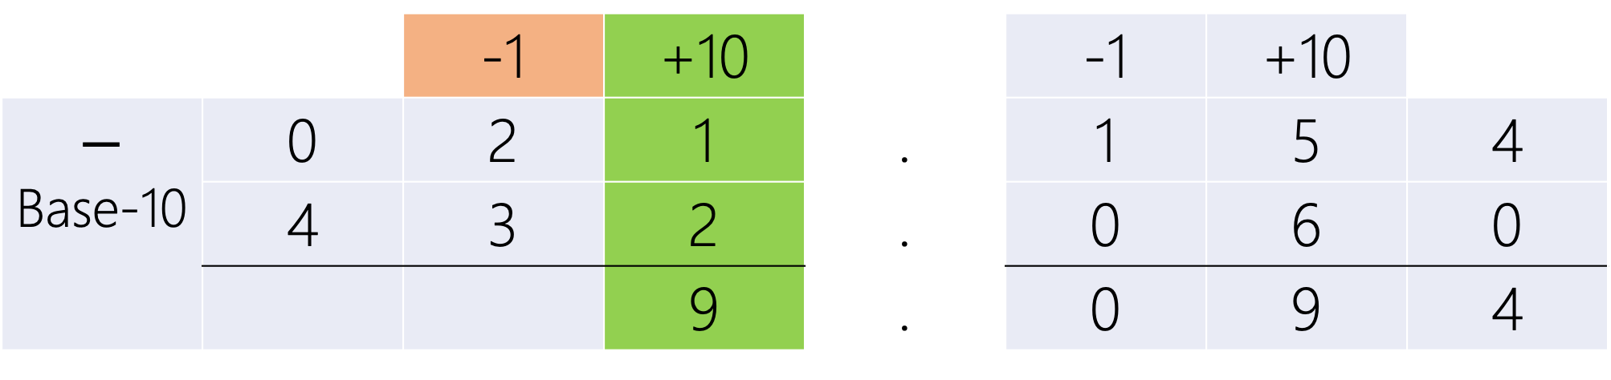
 |  | -1 | +10 |  | -1 | +10
$$−$$ Base-10 | 0 | 2 | 1 | . | 1 | 5 | 4
 | 4 | 3 | 2 | . | 0 | 6 | 0
 |  |  | 9 | . | 0 | 9 | 4

Slide 90
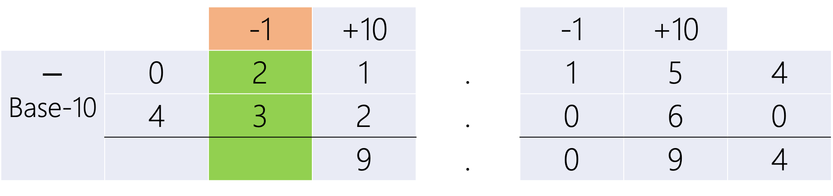
 |  | -1 | +10 |  | -1 | +10
$$−$$ Base-10 | 0 | 2 | 1 | . | 1 | 5 | 4
 | 4 | 3 | 2 | . | 0 | 6 | 0
 |  |  | 9 | . | 0 | 9 | 4

Slide 91
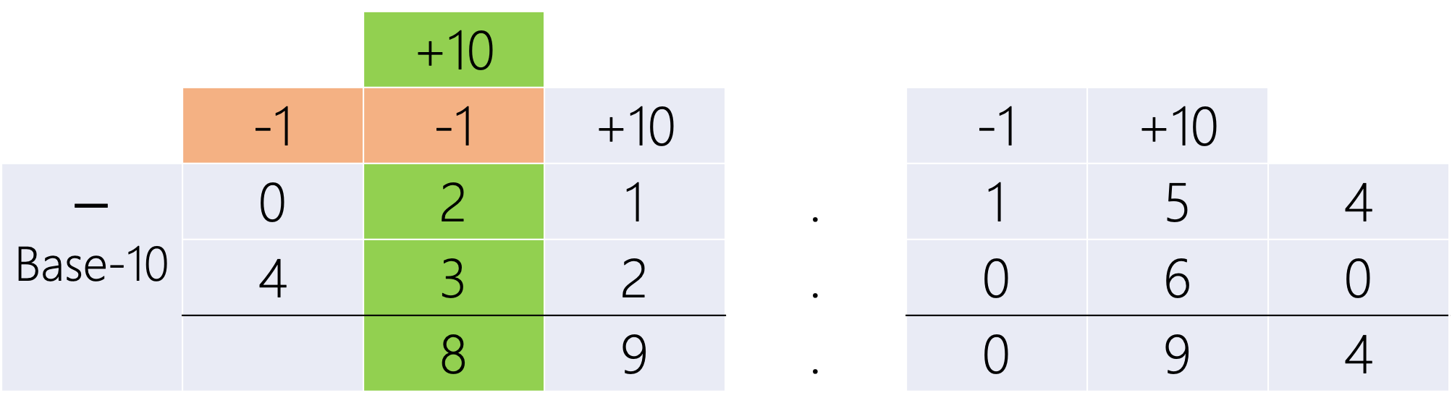
 |  | +10
 | -1 | -1 | +10 |  | -1 | +10
$$−$$ Base-10 | 0 | 2 | 1 | . | 1 | 5 | 4
 | 4 | 3 | 2 | . | 0 | 6 | 0
 |  | 8 | 9 | . | 0 | 9 | 4

Slide 92
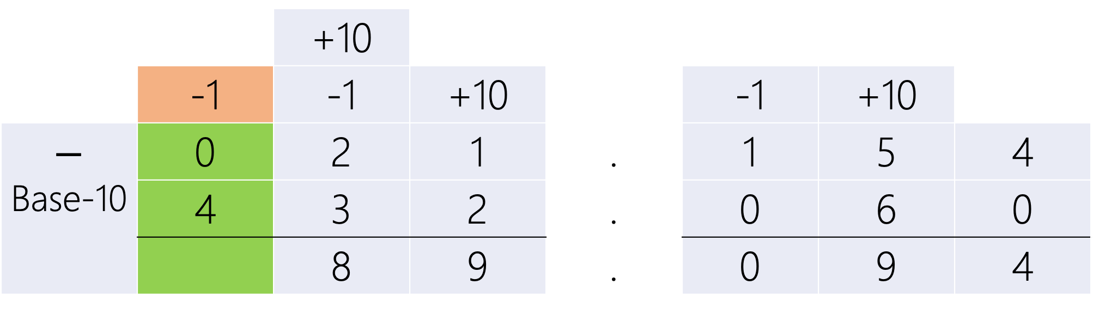
 |  | +10
 | -1 | -1 | +10 |  | -1 | +10
$$−$$ Base-10 | 0 | 2 | 1 | . | 1 | 5 | 4
 | 4 | 3 | 2 | . | 0 | 6 | 0
 |  | 8 | 9 | . | 0 | 9 | 4

Slide 93
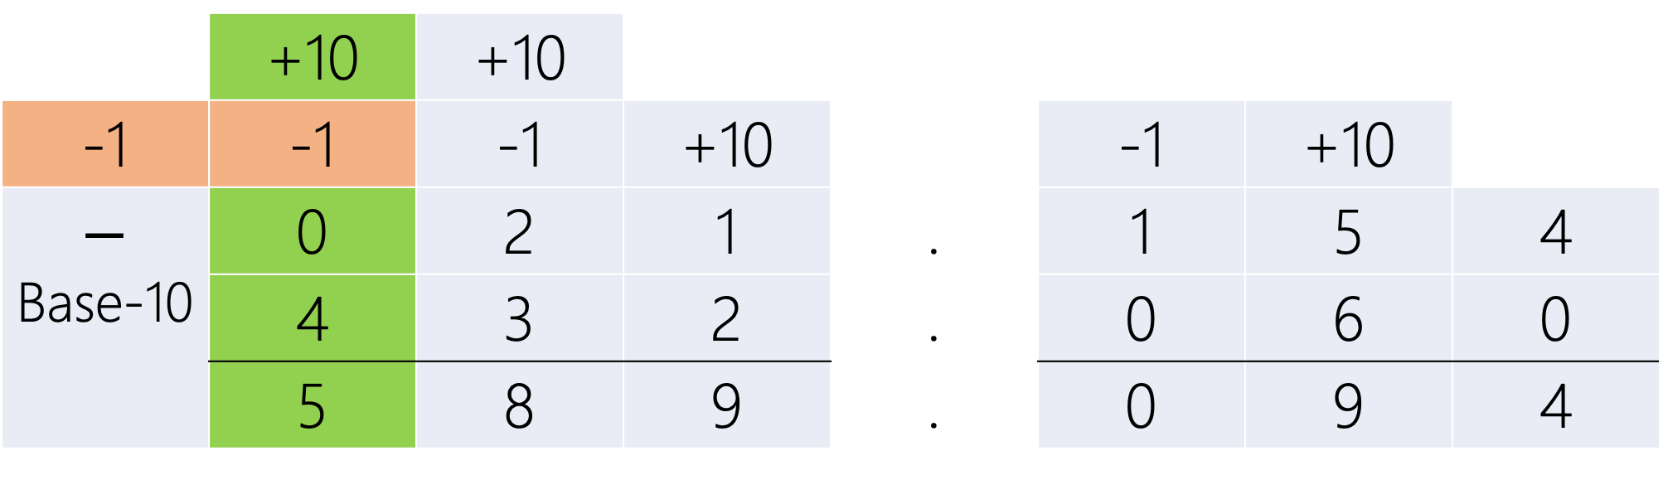
 | +10 | +10
-1 | -1 | -1 | +10 |  | -1 | +10
$$−$$ Base-10 | 0 | 2 | 1 | . | 1 | 5 | 4
 | 4 | 3 | 2 | . | 0 | 6 | 0
 | 5 | 8 | 9 | . | 0 | 9 | 4

Slide 94
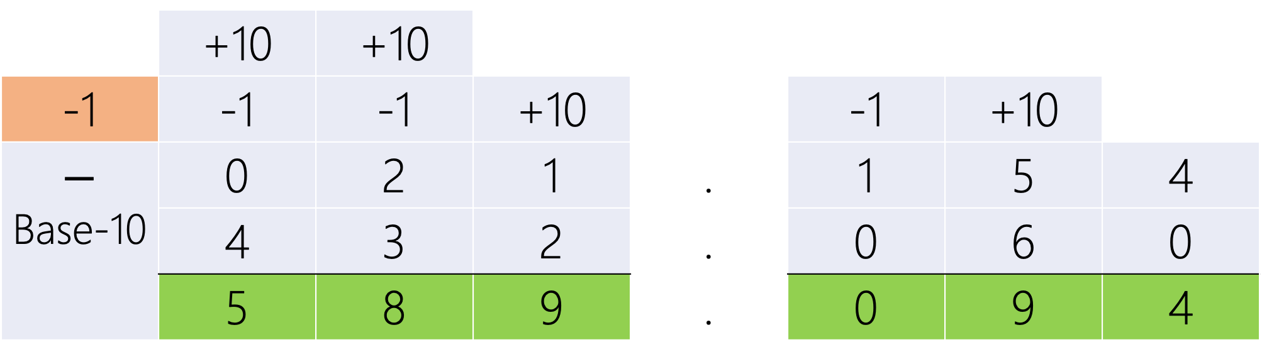
 | +10 | +10
-1 | -1 | -1 | +10 |  | -1 | +10
$$−$$ Base-10 | 0 | 2 | 1 | . | 1 | 5 | 4
 | 4 | 3 | 2 | . | 0 | 6 | 0
 | 5 | 8 | 9 | . | 0 | 9 | 4
021.154 < 432.060

Slide 95
 | +10 | +10
-1 | -1 | -1 | +10 |  | -1 | +10
$$−$$ Base-10 | 0 | 2 | 1 | . | 1 | 5 | 4
 | 4 | 3 | 2 | . | 0 | 6 | 0
 | 5 | 8 | 9 | . | 0 | 9 | 4
021.154 < 432.060
Last Borrow → Negative Result

Slide 96
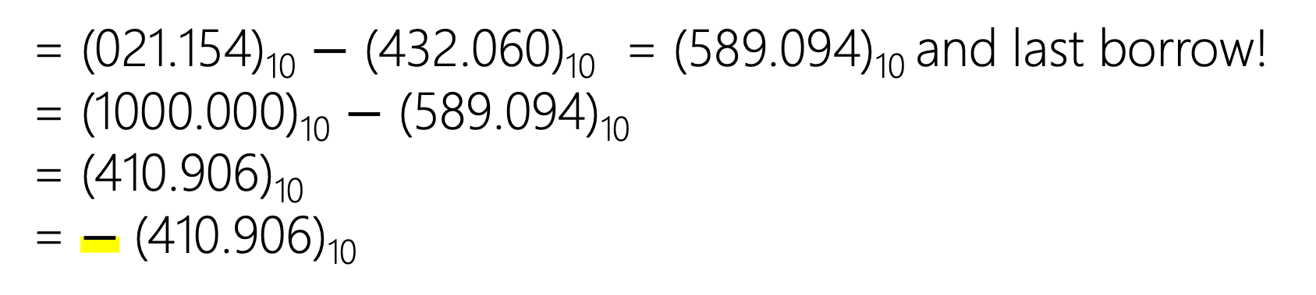
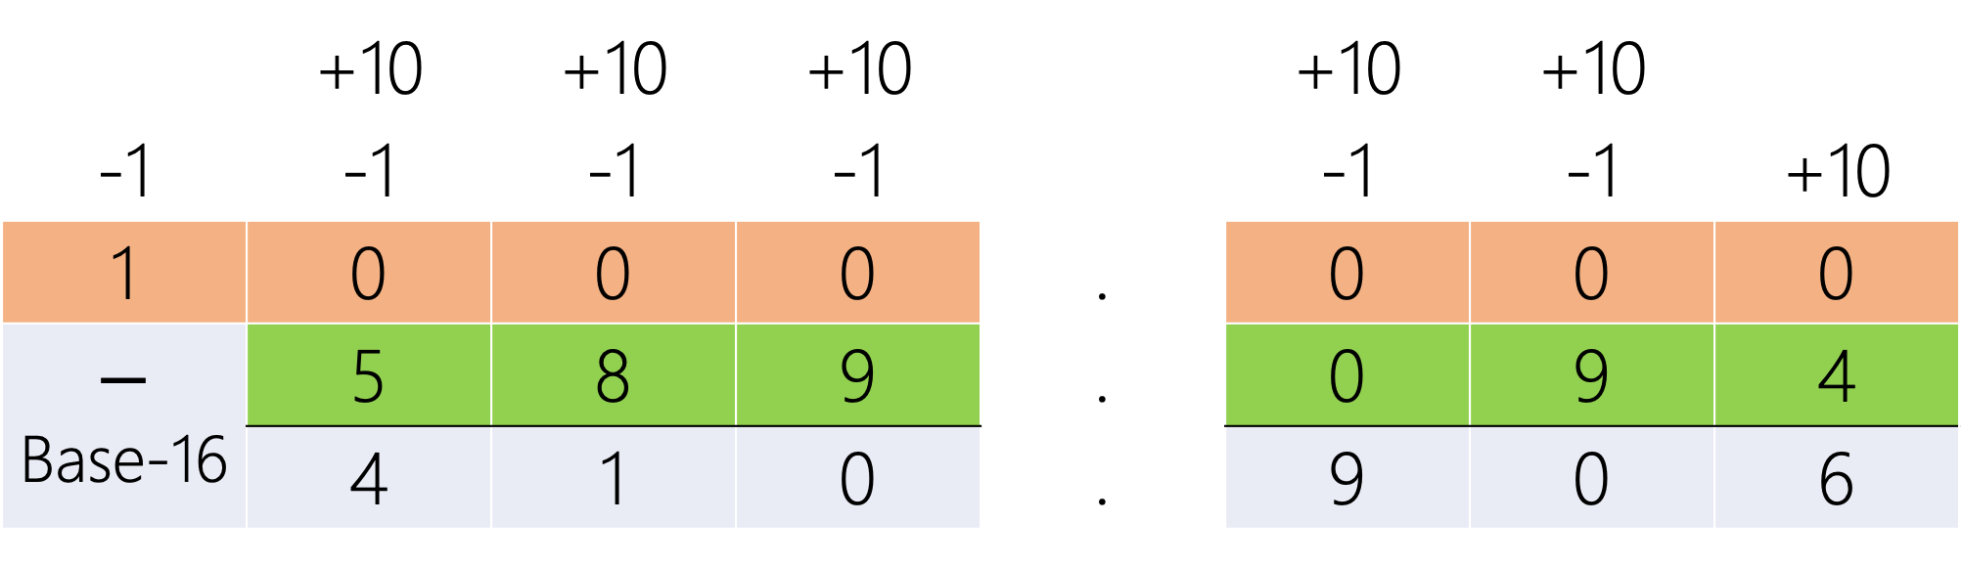
 | +10 | +10 | +10 |  | +10 | +10
-1 | -1 | -1 | -1 |  | -1 | -1 | +10
1 | 0 | 0 | 0 | . | 0 | 0 | 0
$$−$$ Base-16 | 5 | 8 | 9 | . | 0 | 9 | 4
 | 4 | 1 | 0 | . | 9 | 0 | 6
= (021.154)₁₀ $−$ (432.060)₁₀ = (589.094)₁₀ and last borrow!
= (1000.000)₁₀ $−$ (589.094)₁₀
= (410.906)₁₀
= $−$ (410.906)₁₀

Slide 97
subtraction
Example II

Slide 98
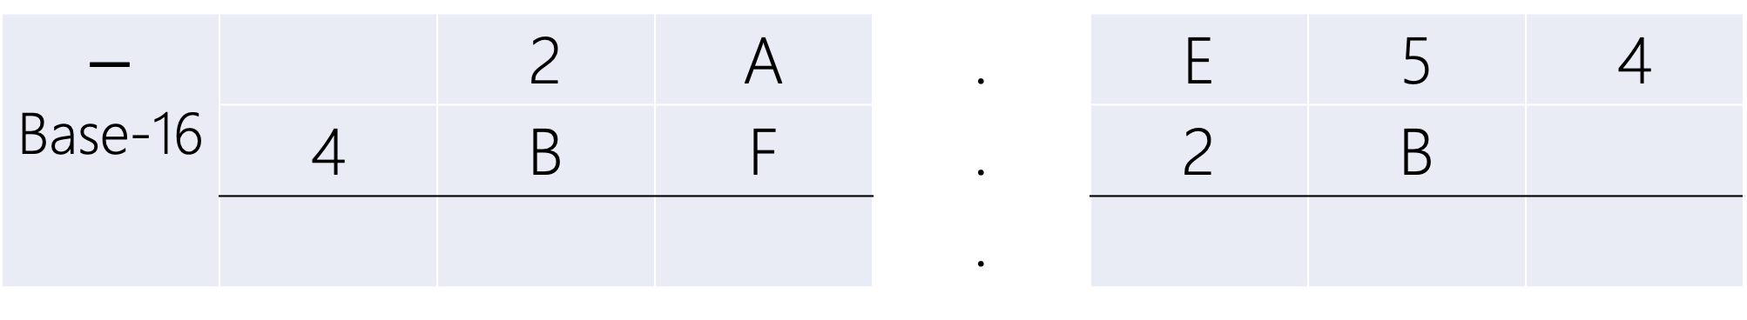
$$−$$ Base-16 |  | 2 | A | . | E | 5 | 4
 | 4 | B | F | . | 2 | B
 |  |  |  | .

Slide 99

padding
$$−$$ Base-16 | 0 | 2 | A | . | E | 5 | 4
 | 4 | B | F | . | 2 | B | 0
 |  |  |  | .

Slide 100

$$−$$ Base-16 | 0 | 2 | A | . | E | 5 | 4
 | 4 | B | F | . | 2 | B | 0
 |  |  |  | . |  |  | 4

Slide 101
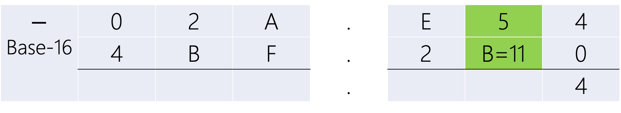
$$−$$ Base-16 | 0 | 2 | A | . | E | 5 | 4
 | 4 | B | F | . | 2 | B=11 | 0
 |  |  |  | . |  |  | 4

Slide 102
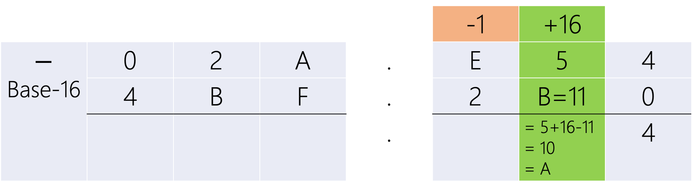
Borrow
 |  |  |  |  | -1 | +16
$$−$$ Base-16 | 0 | 2 | A | . | E | 5 | 4
 | 4 | B | F | . | 2 | B=11 | 0
 |  |  |  | . |  | = 5+16-11 = 10 = A | 4

Slide 103

 |  |  |  |  | -1 | +16
$$−$$ Base-16 | 0 | 2 | A | . | E | 5 | 4
 | 4 | B | F | . | 2 | B | 0
 |  |  |  | . |  | A | 4

Slide 104

 |  |  |  |  | -1 | +16
$$−$$ Base-16 | 0 | 2 | A | . | E=14 | 5 | 4
 | 4 | B | F | . | 2 | B | 0
 |  |  |  | . | B=11 | A | 4

Slide 105
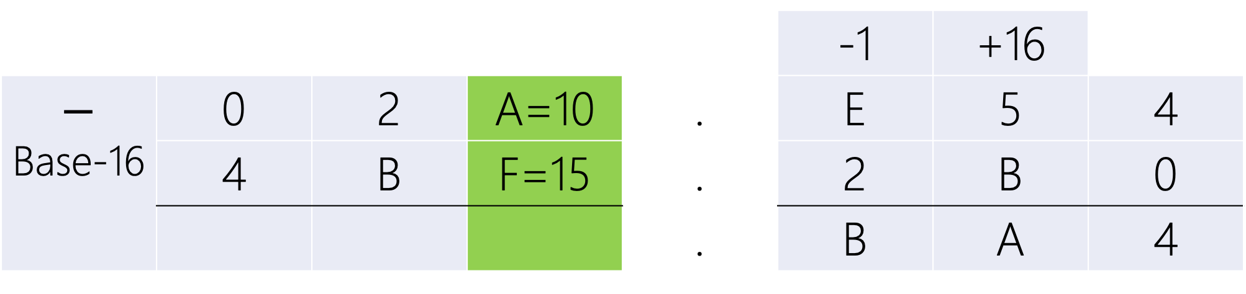
 |  |  |  |  | -1 | +16
$$−$$ Base-16 | 0 | 2 | A=10 | . | E | 5 | 4
 | 4 | B | F=15 | . | 2 | B | 0
 |  |  |  | . | B | A | 4

Slide 106

 |  | -1 | +16 |  | -1 | +16
$$−$$ Base-16 | 0 | 2 | A=10 | . | E | 5 | 4
 | 4 | B | F=15 | . | 2 | B | 0
 |  |  | B=11 | . | B | A | 4

Slide 107

 |  | -1 | +16 |  | -1 | +16
$$−$$ Base-16 | 0 | 2 | A | . | E | 5 | 4
 | 4 | B=11 | F | . | 2 | B | 0
 |  |  | B | . | B | A | 4

Slide 108

 |  | +16
 | -1 | -1 | +16 |  | -1 | +16
$$−$$ Base-16 | 0 | 2 | A | . | E | 5 | 4
 | 4 | B=11 | F | . | 2 | B | 0
 |  | 6 | B | . | B | A | 4

Slide 109

 |  | +16
 | -1 | -1 | +16 |  | -1 | +16
$$−$$ Base-16 | 0 | 2 | A | . | E | 5 | 4
 | 4 | B | F | . | 2 | B | 0
 |  | 6 | B | . | B | A | 4

Slide 110
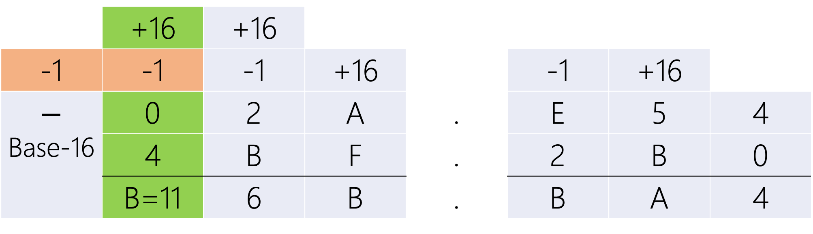
 | +16 | +16
-1 | -1 | -1 | +16 |  | -1 | +16
$$−$$ Base-16 | 0 | 2 | A | . | E | 5 | 4
 | 4 | B | F | . | 2 | B | 0
 | B=11 | 6 | B | . | B | A | 4

Slide 111

 | +16 | +16
-1 | -1 | -1 | +16 |  | -1 | +16
$$−$$ Base-16 | 0 | 2 | A | . | E | 5 | 4
 | 4 | B | F | . | 2 | B | 0
 | B | 6 | B | . | B | A | 4
02A.E54 < 4BF.2B0

Slide 112
 | +16 | +16
-1 | -1 | -1 | +16 |  | -1 | +16
$$−$$ Base-16 | 0 | 2 | A | . | E | 5 | 4
 | 4 | B | F | . | 2 | B | 0
 | B | 6 | B | . | B | A | 4
02A.E54 < 4BF.2B0
Last Borrow → Negative Result

Slide 113
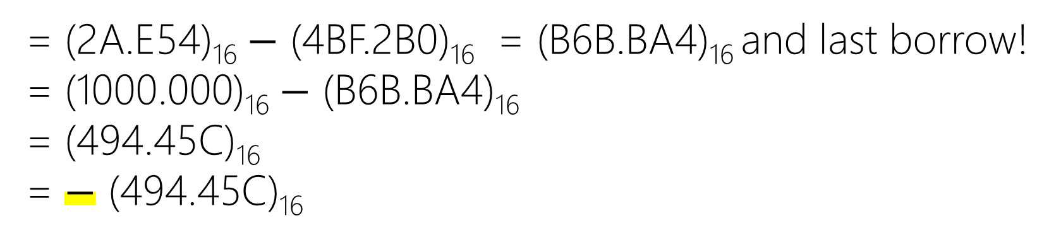

 | +16 | +16 | +16 |  | +16 | +16
-1 | -1 | -1 | -1 |  | -1 | -1 | +16
1 | 0 | 0 | 0 | . | 0 | 0 | 0
$$−$$ Base-16 | B=11 | 6 | B=11 | . | B=11 | A=10 | 4
 | 4 | 9 | 4 | . | 4 | 5 | C=12
= (2A.E54)₁₆ $−$ (4BF.2B0)₁₆ = (B6B.BA4)₁₆ and last borrow!
= (1000.000)₁₆ $−$ (B6B.BA4)₁₆
= (494.45C)₁₆
= $−$ (494.45C)₁₆

Slide 114
division

Slide 115
Negative numbers

Slide 116
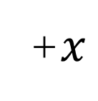
10⁰
0
1
2
3
4
5
6
7
8
9
+$x$
0 | 1 | 2 | 3 | 4 | 5 | 6 | 7 | 8 | 9

Slide 117
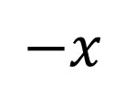
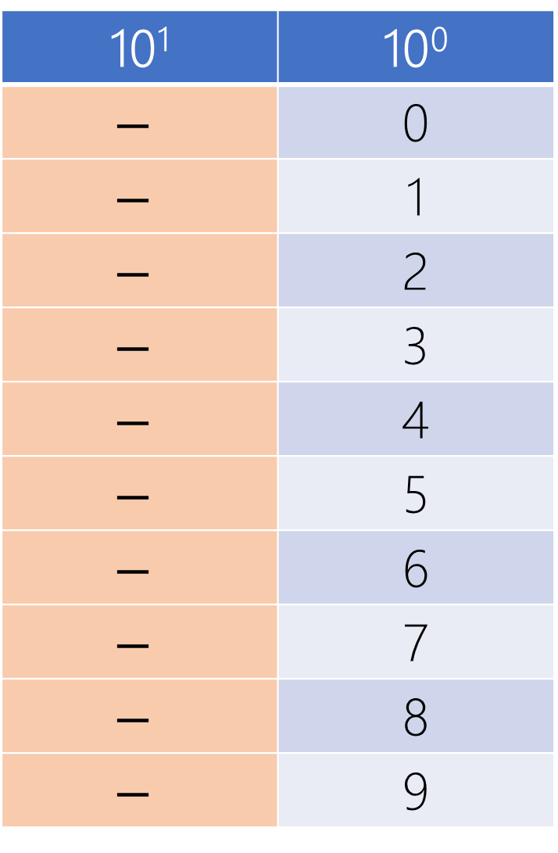
10¹ | 10⁰
$$−$$ | 0
$$−$$ | 1
$$−$$ | 2
$$−$$ | 3
$$−$$ | 4
$$−$$ | 5
$$−$$ | 6
$$−$$ | 7
$$−$$ | 8
$$−$$ | 9
$$−x$$
-9 | -8 | -7 | -6 | -5 | -4 | -3 | -2 | -1 | -0

Slide 118
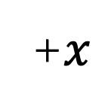
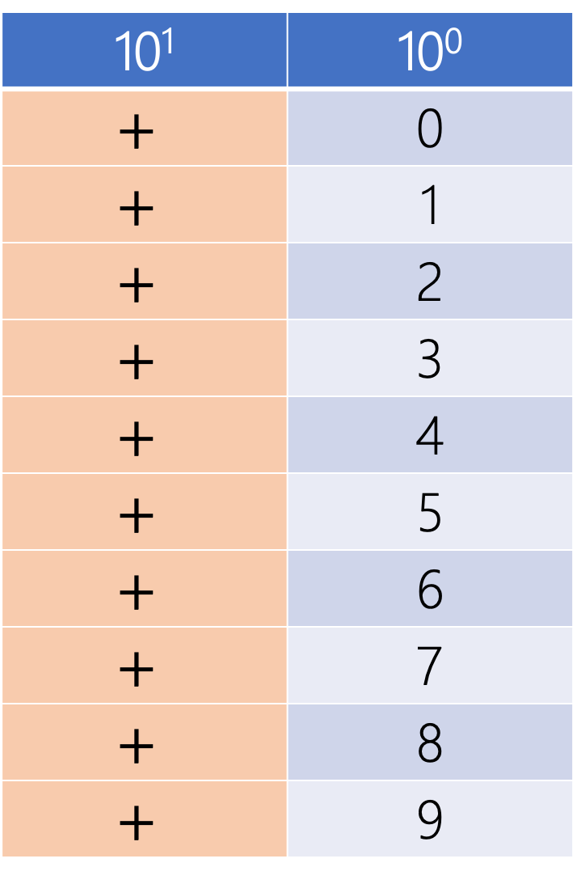
10¹ | 10⁰
$$+$$ | 0
$$+$$ | 1
$$+$$ | 2
$$+$$ | 3
$$+$$ | 4
$$+$$ | 5
$$+$$ | 6
$$+$$ | 7
$$+$$ | 8
$$+$$ | 9
+$x$
+0 | +1 | +2 | +3 | +4 | +5 | +6 | +7 | +8 | +9

Slide 119
10¹ | 10⁰
0 | 0
0 | 1
0 | 2
0 | 3
0 | 4
0 | 5
0 | 6
0 | 7
0 | 8
0 | 9
+$x$
+0 | +1 | +2 | +3 | +4 | +5 | +6 | +7 | +8 | +9

Slide 120
10¹ | 10⁰
1 | 0
1 | 1
1 | 2
1 | 3
1 | 4
1 | 5
1 | 6
1 | 7
1 | 8
1 | 9
$$−x$$
-9 | -8 | -7 | -6 | -5 | -4 | -3 | -2 | -1 | -0

Slide 121
10¹ | 10⁰
Nonzero | 0
Nonzero | 1
Nonzero | 2
Nonzero | 3
Nonzero | 4
Nonzero | 5
Nonzero | 6
Nonzero | 7
Nonzero | 8
Nonzero | 9
$$−x$$
-9 | -8 | -7 | -6 | -5 | -4 | -3 | -2 | -1 | -0

Slide 122
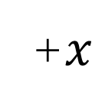
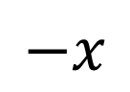
10¹ | 10⁰
1,2,…9 | 0
1,2,…9 | 1
1,2,…9 | 2
1,2,…9 | 3
1,2,…9 | 4
1,2,…9 | 5
1,2,…9 | 6
1,2,…9 | 7
1,2,…9 | 8
1,2,…9 | 9
10¹ | 10⁰
0 | 0
0 | 1
0 | 2
0 | 3
0 | 4
0 | 5
0 | 6
0 | 7
0 | 8
0 | 9
+$x$
0 | 1 | 2 | 3 | 4 | 5 | 6 | 7 | 8 | 9
$$−x$$
-9 | -8 | -7 | -6 | -5 | -4 | -3 | -2 | -1 | -0

Slide 123
10¹ | 10⁰
1,2,…9 | 0
1,2,…9 | 1
1,2,…9 | 2
1,2,…9 | 3
1,2,…9 | 4
1,2,…9 | 5
1,2,…9 | 6
1,2,…9 | 7
1,2,…9 | 8
1,2,…9 | 9
10¹ | 10⁰
0 | 0
0 | 1
0 | 2
0 | 3
0 | 4
0 | 5
0 | 6
0 | 7
0 | 8
0 | 9
+$x$
0 | 1 | 2 | 3 | 4 | 5 | 6 | 7 | 8 | 9
$$−x$$
-9 | -8 | -7 | -6 | -5 | -4 | -3 | -2 | -1 | -0

Slide 124
Signed magnitude

Slide 125
r^{n-1} | r^{n-2} | r^{n-3} | … | r² | r¹ | r⁰
0 | Positive Numbers
Nonzero | Negative Numbers
Signed
Magnitude

Slide 126
Give up left most position for sign!
r^{n-1} | r^{n-2} | r^{n-3} | … | r² | r¹ | r⁰
0 | Positive Numbers
Nonzero | Negative Numbers
0 → Max = r^{n-1} -1 = r^{n} -1
Min= - (r^{n-1} -1) ← 0

Slide 127
2⁵ | 2⁴ | 2³ | 2² | 2¹ | 2⁰ |  | Interpretation
0 | 0 | 0 | 0 | 1 | 1 |  | +3
1 | 0 | 0 | 1 | 0 | 1 |  | -5
7⁵ | 7⁴ | 7³ | 7² | 7¹ | 7⁰ |  | Interpretation
0 | 0 | 0 | 0 | 5 | 6 |  | +41
1 | 0 | 0 | 2 | 0 | 5 |  | -103
4 | 0 | 0 | 2 | 0 | 5 |  | -103
6 | 0 | 0 | 2 | 0 | 5 |  | -103

Slide 128
Signed magnitude
arithmetic

Slide 129
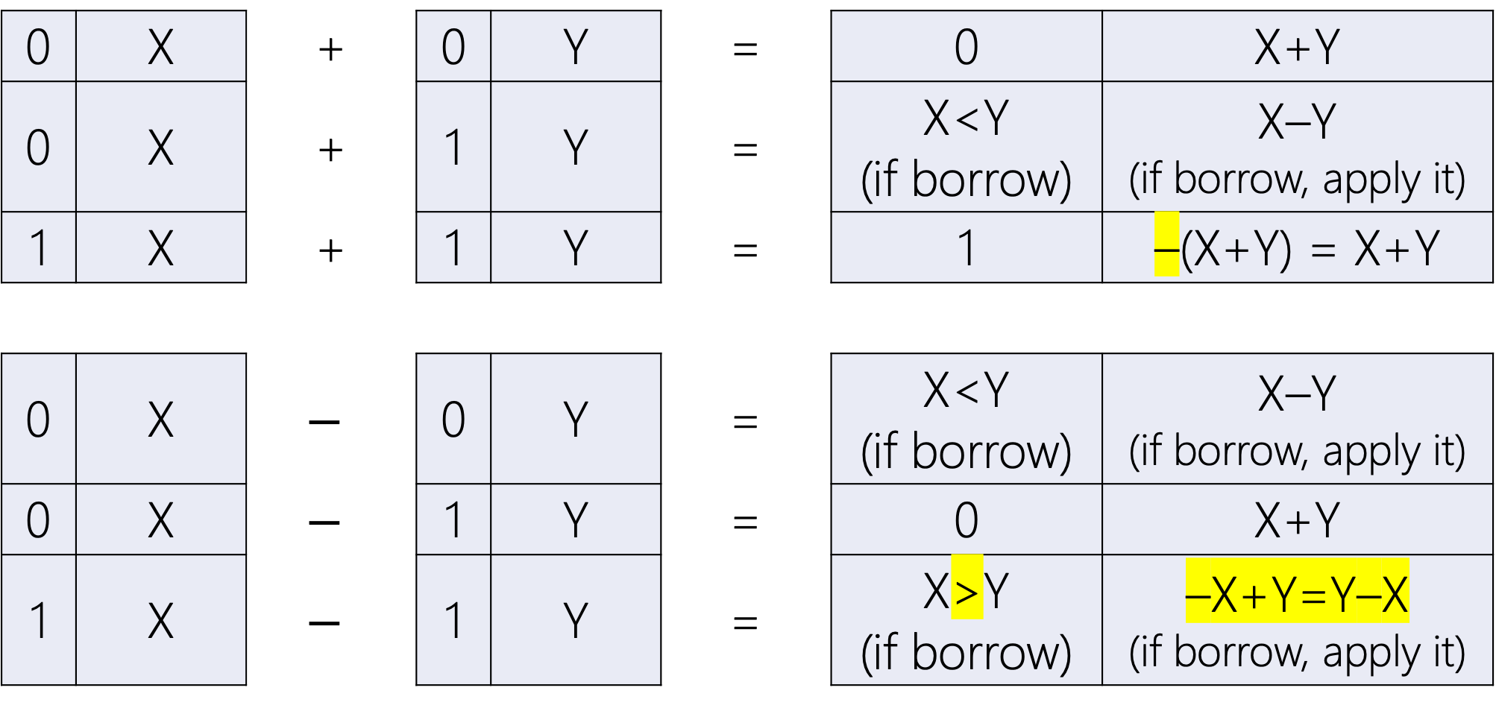
0 | X | + | 0 | Y | = | 0 | X+Y
0 | X | + | 1 | Y | = | X<Y (if borrow) | X–Y (if borrow, apply it)
1 | X | + | 1 | Y | = | 1 | –(X+Y) = X+Y
0 | X | $$−$$ | 0 | Y | = | X<Y (if borrow) | X–Y (if borrow, apply it)
0 | X | $$−$$ | 1 | Y | = | 0 | X+Y
1 | X | $$−$$ | 1 | Y | = | X>Y (if borrow) | –X+Y=Y–X (if borrow, apply it)

Slide 130
Signed magnitude
Example I

Slide 131
+ Base-16 | 1 | 2 | A | . | E | 5 | 4
 | 1 | B | F | . | 2 | B
 |  |  |  | .

Slide 132
+ Base-16 | 1 | 2 | A | . | E | 5 | 4
 | 1 | B | F | . | 2 | B
 |  |  |  | .

Slide 133
padding
+ Base-16 | 1 | 2 | A | . | E | 5 | 4
 | 1 | B | F | . | 2 | B | 0
 |  |  |  | .

Slide 134
Signed: (–X)+(–Y)=–(X+Y)
+ Base-16 | 1 | 2 | A | . | E | 5 | 4
 | 1 | B | F | . | 2 | B | 0
 | 1 |  |  | .

Slide 135
 |  | 1 | 1 |  | 1
+ Base-16 | 1 | 2 | A=10 | . | E=14 | 5 | 4
 | 1 | B | F=15 | . | 2 | B=11 | 0
 | 1 | E=14 | A=10 | . | 1 | 0 | 4

Slide 136
Signed magnitude
Example II

Slide 137
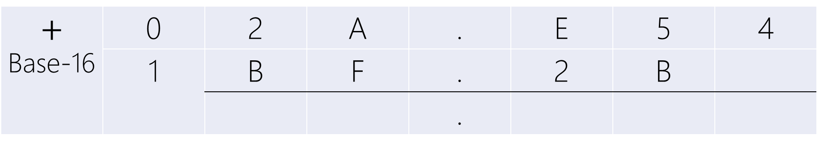
$$+$$ Base-16 | 0 | 2 | A | . | E | 5 | 4
 | 1 | B | F | . | 2 | B
 |  |  |  | .

Slide 138
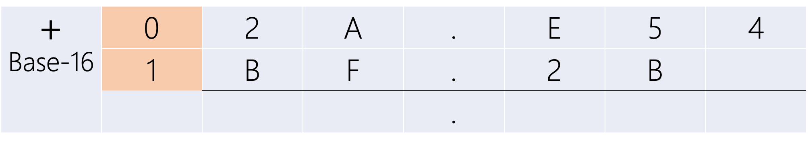
$$+$$ Base-16 | 0 | 2 | A | . | E | 5 | 4
 | 1 | B | F | . | 2 | B
 |  |  |  | .

Slide 139
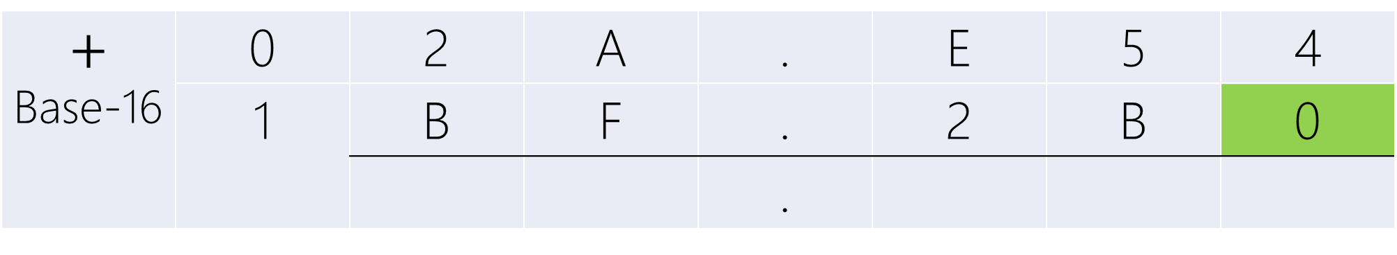
padding
$$+$$ Base-16 | 0 | 2 | A | . | E | 5 | 4
 | 1 | B | F | . | 2 | B | 0
 |  |  |  | .

Slide 140
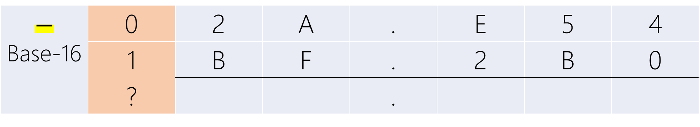
Signed: (+X)+(–Y)=?(X–Y)
$$−$$ Base-16 | 0 | 2 | A | . | E | 5 | 4
 | 1 | B | F | . | 2 | B | 0
 | ? |  |  | .

Slide 141
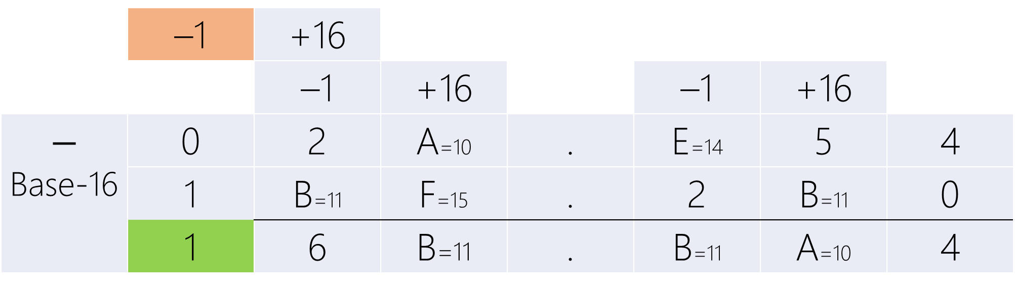
 | –1 | +16
 |  | –1 | +16 |  | –1 | +16
$$−$$ Base-16 | 0 | 2 | A=10 | . | E=14 | 5 | 4
 | 1 | B=11 | F=15 | . | 2 | B=11 | 0
 | 1 | 6 | B=11 | . | B=11 | A=10 | 4
2A.E54 < BF.2B0
Last Borrow → Negative Result

Slide 142
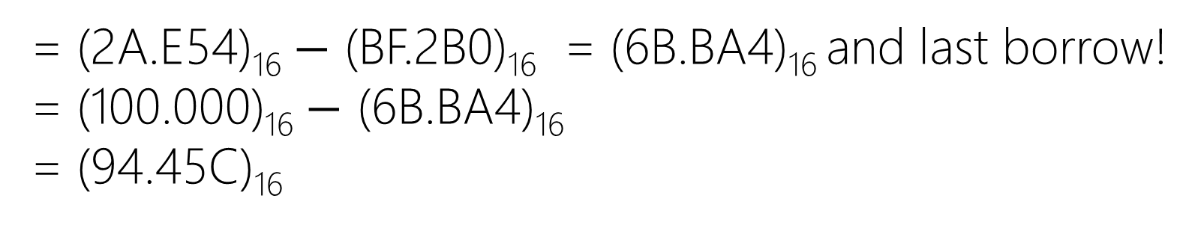
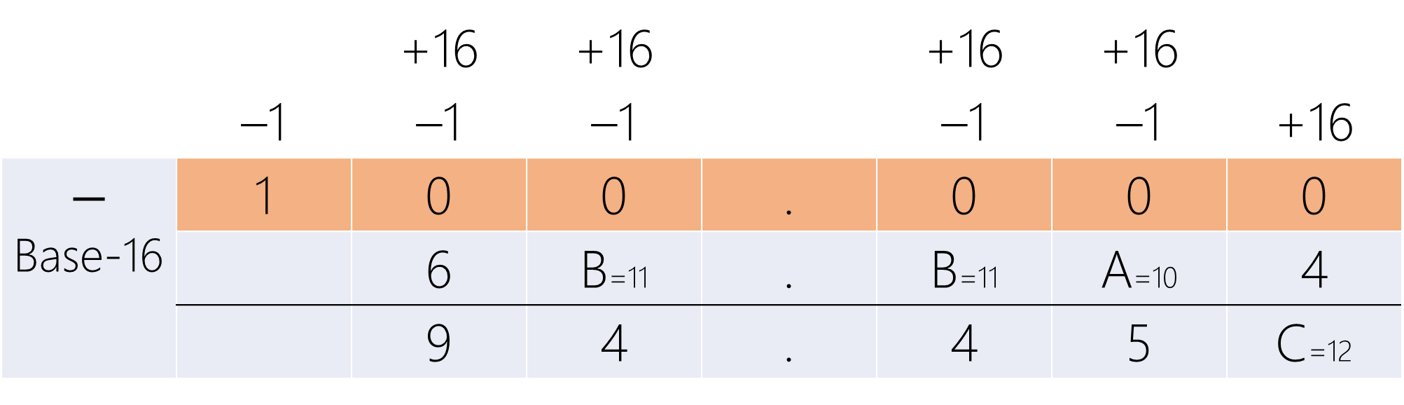
 |  | +16 | +16 |  | +16 | +16
 | –1 | –1 | –1 |  | –1 | –1 | +16
$$−$$ Base-16 | 1 | 0 | 0 | . | 0 | 0 | 0
 |  | 6 | B=11 | . | B=11 | A=10 | 4
 |  | 9 | 4 | . | 4 | 5 | C=12
= (2A.E54)₁₆ $−$ (BF.2B0)₁₆ = (6B.BA4)₁₆ and last borrow!
= (100.000)₁₆ $−$ (6B.BA4)₁₆
= (94.45C)₁₆

Slide 143
 | –1 | +16
 |  | –1 | +16 |  | –1 | +16
$$−$$ Base-16 | 0 | 2 | A=10 | . | E=14 | 5 | 4
 | 1 | B=11 | F=15 | . | 2 | B=11 | 0
 | 1 | 6 | B=11 | . | B=11 | A=10 | 4
2A.E54 < BF.2B0
Last Borrow → Negative Result
1 | 9 | 4 | . | 4 | 5 | C

Slide 144
Signed magnitude
overflow

Slide 145
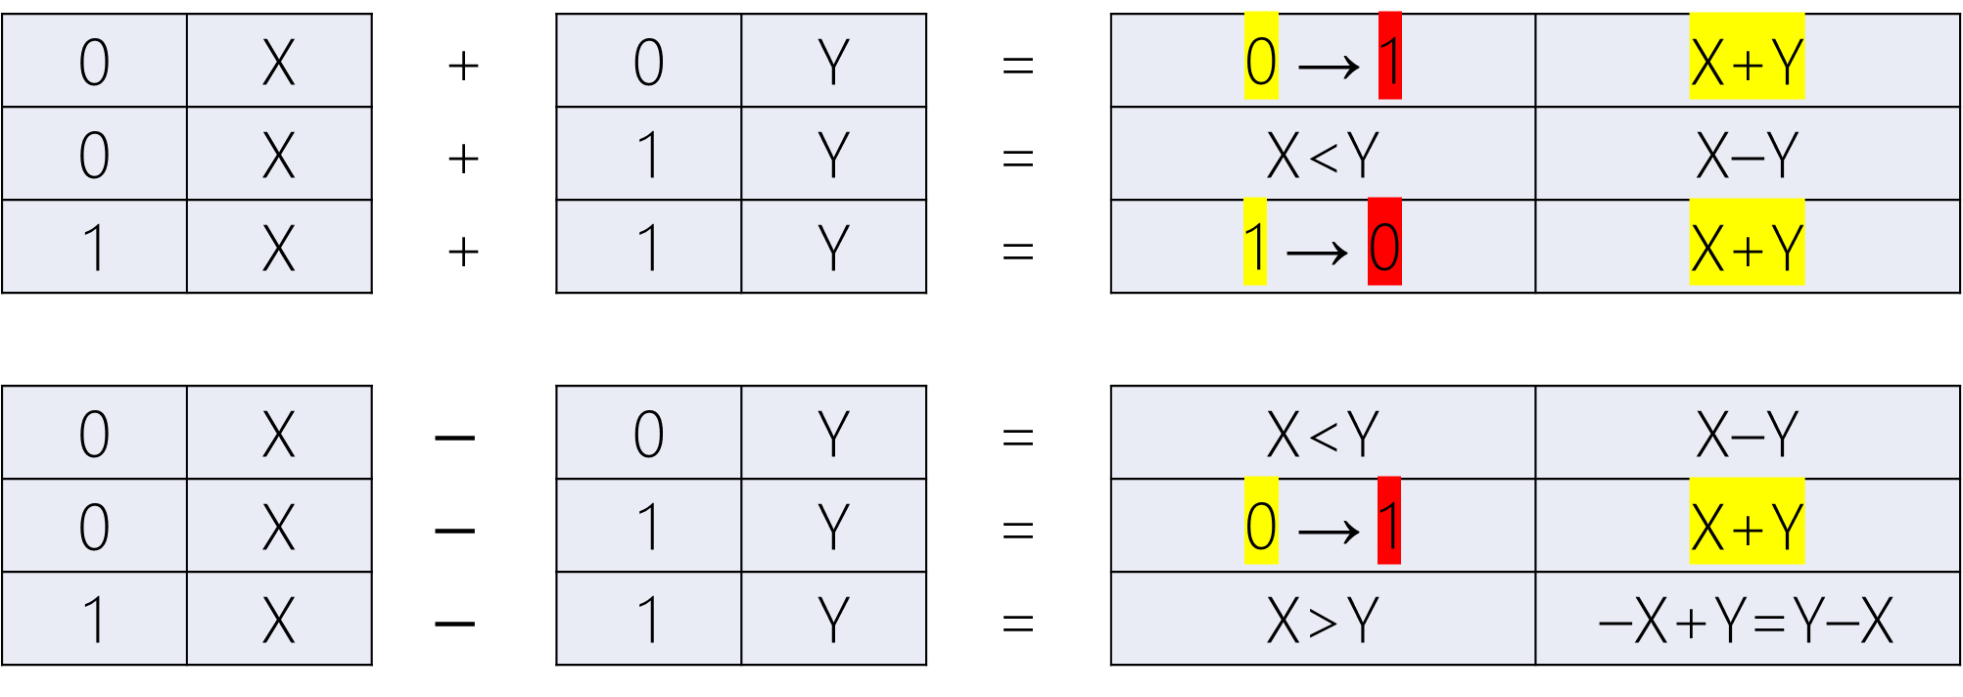
Overflow!
0 | X | + | 0 | Y | = | 0 → 1 | X+Y
0 | X | + | 1 | Y | = | X<Y | X–Y
1 | X | + | 1 | Y | = | 1 → 0 | X+Y
0 | X | $$−$$ | 0 | Y | = | X<Y | X–Y
0 | X | $$−$$ | 1 | Y | = | 0 → 1 | X+Y
1 | X | $$−$$ | 1 | Y | = | X>Y | –X+Y=Y–X

Slide 146
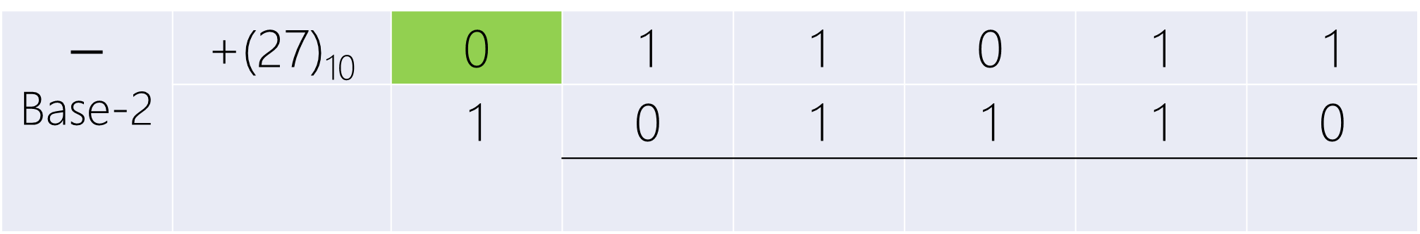
$$−$$ Base-2 | +(27)₁₀ | 0 | 1 | 1 | 0 | 1 | 1
 |  | 1 | 0 | 1 | 1 | 1 | 0

Slide 147
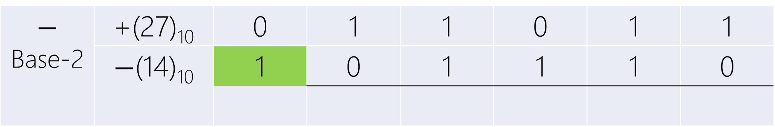
$$−$$ Base-2 | +(27)₁₀ | 0 | 1 | 1 | 0 | 1 | 1
 | $−$(14)₁₀ | 1 | 0 | 1 | 1 | 1 | 0

Slide 148
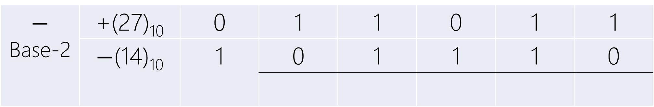
+X – (– Y)
$$−$$ Base-2 | +(27)₁₀ | 0 | 1 | 1 | 0 | 1 | 1
 | $−$(14)₁₀ | 1 | 0 | 1 | 1 | 1 | 0

Slide 149
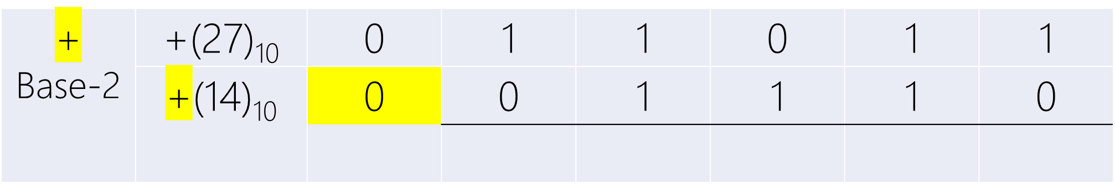
+X – (– Y) = +(X+Y)
$$\text{+}$$ Base-2 | +(27)₁₀ | 0 | 1 | 1 | 0 | 1 | 1
 | $\text{+}$(14)₁₀ | 0 | 0 | 1 | 1 | 1 | 0

Slide 150
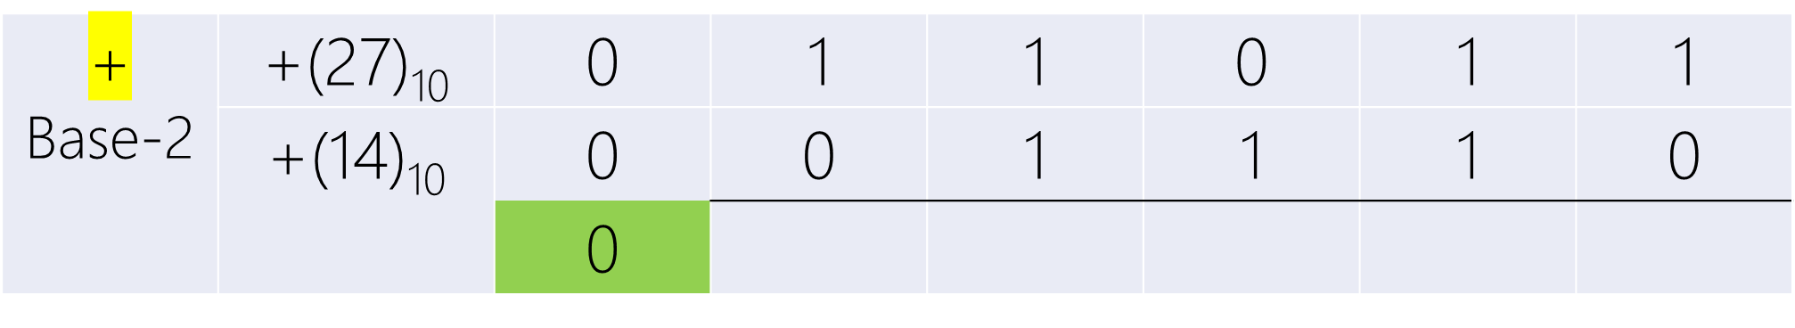
+X – (– Y) = +(X+Y)
$$\text{+}$$ Base-2 | +(27)₁₀ | 0 | 1 | 1 | 0 | 1 | 1
 | $\text{+}$(14)₁₀ | 0 | 0 | 1 | 1 | 1 | 0
 |  | 0

Slide 151
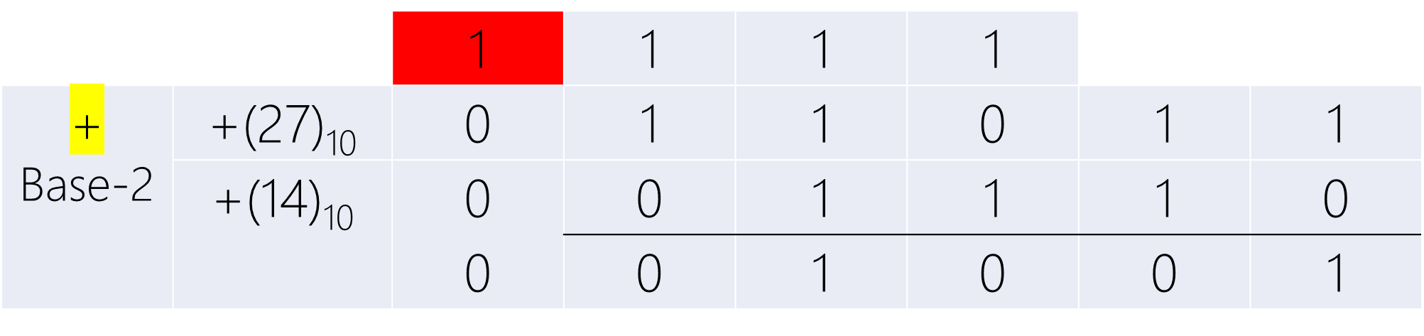
+X – (– Y) = +(X+Y)
 |  | 1 | 1 | 1 | 1
$$\text{+}$$ Base-2 | +(27)₁₀ | 0 | 1 | 1 | 0 | 1 | 1
 | $\text{+}$(14)₁₀ | 0 | 0 | 1 | 1 | 1 | 0
 |  | 0 | 0 | 1 | 0 | 0 | 1

Slide 152
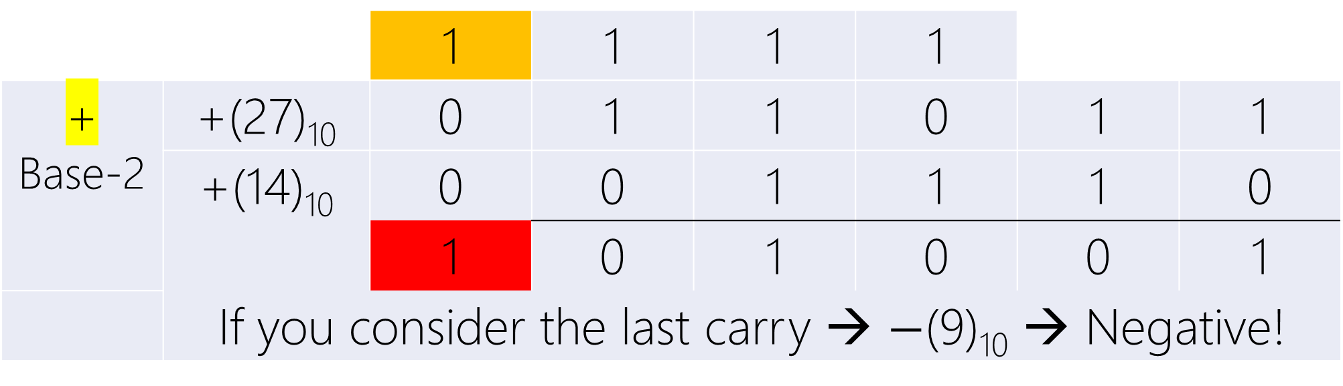
+X – (– Y) = +(X+Y)
 |  | 1 | 1 | 1 | 1
$$\text{+}$$ Base-2 | +(27)₁₀ | 0 | 1 | 1 | 0 | 1 | 1
 | $\text{+}$(14)₁₀ | 0 | 0 | 1 | 1 | 1 | 0
 |  | 1 | 0 | 1 | 0 | 0 | 1
 | If you consider the last carry → $−$(9)₁₀ → Negative!

Slide 153
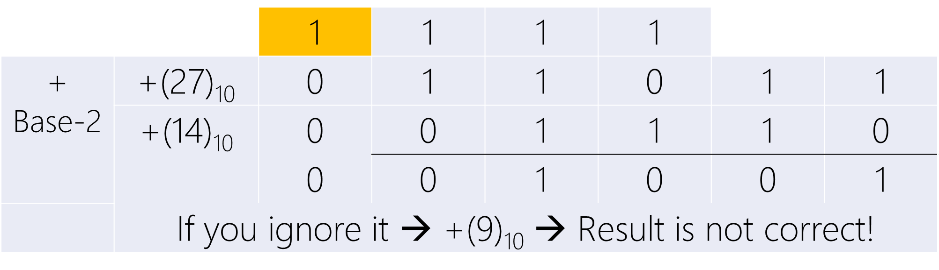
+X – (– Y) = +(X+Y)
 |  | 1 | 1 | 1 | 1
$$\text{+}$$ Base-2 | +(27)₁₀ | 0 | 1 | 1 | 0 | 1 | 1
 | $\text{+}$(14)₁₀ | 0 | 0 | 1 | 1 | 1 | 0
 |  | 0 | 0 | 1 | 0 | 0 | 1
 | If you ignore it → +(9)₁₀ → Result is not correct!

Slide 154
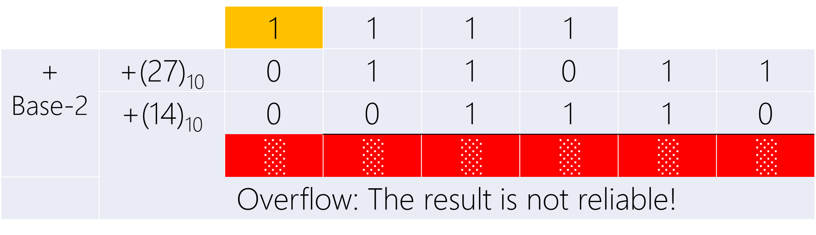
+X – (– Y) = +(X+Y)
 |  | 1 | 1 | 1 | 1
$$\text{+}$$ Base-2 | +(27)₁₀ | 0 | 1 | 1 | 0 | 1 | 1
 | $\text{+}$(14)₁₀ | 0 | 0 | 1 | 1 | 1 | 0
 |  | ░ | ░ | ░ | ░ | ░ | ░
 | Overflow: The result is not reliable!

